Slide 1

Kepler Service
KT 2024
January 2024

Slide 2
Staffing
2

Slide 3



B2B KEPLER PROGRAM 2024 - CAPGEMINI
Program Director
Isabelle
Transverse
Solution Architect
Omar
Data Consultant
Sandy Fadel
Principal BA
Jérémie Seabra
Project Lead Service
Arielle Rochmann
Release Manager
Hamza Krichel
Lead RO Sales
Martha
Sxrum Master
Nour
Release Manager
Rakesh
Sales Roll-out Team
NEO Team
Sales Build Team
Service Build Team
SDM
Amina Belkacem
Business Analyst
Audrey Sanz
Business Analyst
Noha Mansy
Business Analyst
Nour Bagdadi
Business Analyst
Evgeniia Mochkaeva
Incident Management Team
Business Analyst Astou Lebre
Business Analyst TBD
Business Analyst
TBD
Business Analyst
Morgan Contencin
Service Delivery Manager
Ravi Kumar
Business Analyst Jade Gauthier
Software Engineer
Radhika Kollamoran
Software Engineer
Aryaki Pathak
Software Engineer
Rémi Audureau
Software Engineer
Nagaraja Guruguntla
Software Engineer
Harish Chirumamilla
Software Engineer
Shaik Afrid
Software Engineer
Thulasi Bollavoram
BA/QA
Albaz Mohammed
Software Engineer
Elson Godinho
Software Engineer Poormina Kamaraju
Software Engineer CTI
Abdenacer Mahdoudi
Software Engineer
Suyash Pillai
Software Engineer
Mousumi Das
Quality Assurance
Rohit Shahaji
Quality Assurance
TBD
Quality Assurance Prasad V
Quality Assurance/BA
Sofia Pernas / Sindhuja
Tech Lead
Prabhu
Technical Leader
Sohom Mitra
Technical Leader
Hugo Brites
Technical Leader
Carlos Fusco / Usha

Slide 4
B2B KEPLER PROGRAM 2024 - CAPGEMINI
Kepler Service Team
Project Lead Service
Arielle Rochmann
Senior Business Analyst
Morgan Contencin
Junior Business Analyst
Evgeniia Mochkaeva
Technical Leader
Usha Hande
Software Engineer
Shaik Afrid
Software Engineer
Harish Chirumamilla
Software Engineer CTI
Abdenacer Mahdoudi
Quality Assurance
Sindhuja Tarigoppula

Slide 5
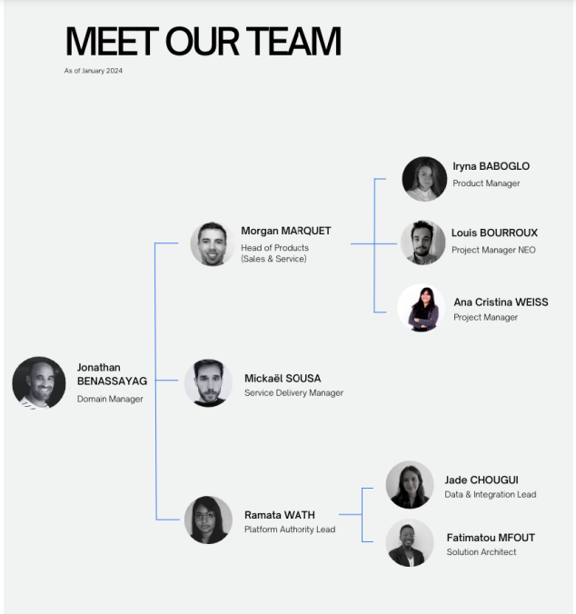
B2B KEPLER PROGRAM 2024 – L’OREAL

Slide 6
GLOBAL OVERVIEW
2

Slide 7

Project context
Kepler Service is a plateform for the agents & managers from the Customer Care Service at l’Oréal.
Customer Care Service is multidiv (PPD, LLD, CPD, LDB)
Agents can :
Easily contact the customers
Have all the informations they need in one place (customer centric view)
Customer can :
Contact the customer care service through several channels

Slide 8





















Project context
Hubs live on NextGen
France
Italy
Iberia
UKI
Nordics
DACH
BNL
Squad
Arielle (PPL)
Salesforce Objects Data model
Carlos/Usha (TL)
Morgan (PL)
L'Oréal
Harish Afrid Abdenacer (Devs)
Evgeniia, Morgan (BA)
Sofia/Sindhuja (QA)

Slide 9





PRODUCT DESCRIPTION
Why L'Oréal clients contact the Customer Care Service ?
Order creation/validation
Returns / Refusals
Claims (pricing, logistic)
Generic (document copy)
Automatic creation with typification
Assignment rules
Agents can work on cases
Actions in Kepler & SAP
Case resolution and closing (manual or automatic)

Slide 10
SAP2Case Process Catalog
ORDER TO DELIVERY &
INVOICE TO CASH (13 WF)
REVERSE FLOWS
& CLAIMS (5 WF)
SPECIFIC by COUNTRY
ORDER CREATION
#1 - Order Recording Request
#8 - Order Follow up, Order Cancellation, Order Modification
ORDER VALIDATION
#2 - Rejecting by minimum order
#3 - Blocked by incomplete data
#4 - Price difference (SP only)
#5 - Parallel Market Risk
#6 - Blocked by comments
#7 – Blocked by SAP Workflow blocking
#19 - Blocked by Closed Customer (BL only)
CASH COLLECTION
#9 - Cash Collector (SP only)
#10 – Wire Transfer (SP only)
#17 – Prepayment (BL only)
#18 - Cash on Delivery (BL only)
#21 – Deduction Management (IT only)
NEGOTIATED COMMERCIAL RETURNS
#11 - Returns / Refusal Follow Up
#20 – Delivery Delay (Nordics/France)
REFUSALS
#12 - Refusals
PRICING DISPUTES
#13 - Pricing Claims
LOGISTICS DISPUTES
#14 – Logistic Claims
OTHER CLAIMS
#15 – Document Copy
+ 1 Generic Workflow by country (to capture other activities)
#16 Special event (DEAT only)
#17 Animation promotion (DEAT Only)
* & Email to case
*
*
*
*
*
Each Country decids which WF :
to activate
if new one are needed
* Manual Case Creation & Closure

Slide 11
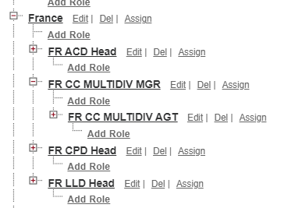
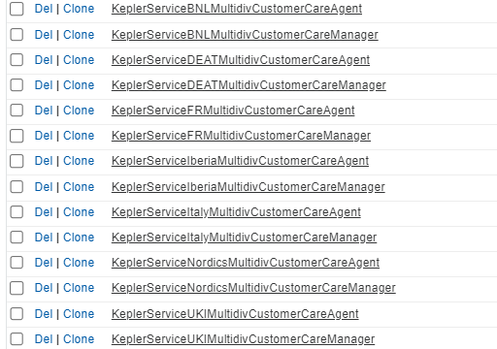
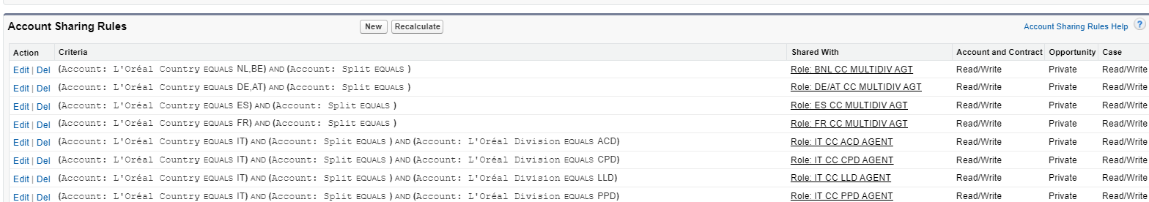
Product description
Roles hierarchy :
Service need to be above Sales roles
2 roles : Manager & Agent
Profiles & sharing :
Separate profiles per Hub
2 profiles : Manager & Agent
Sharing rules on Account per Hub
Service users don’t see « Split » Accounts

Slide 12
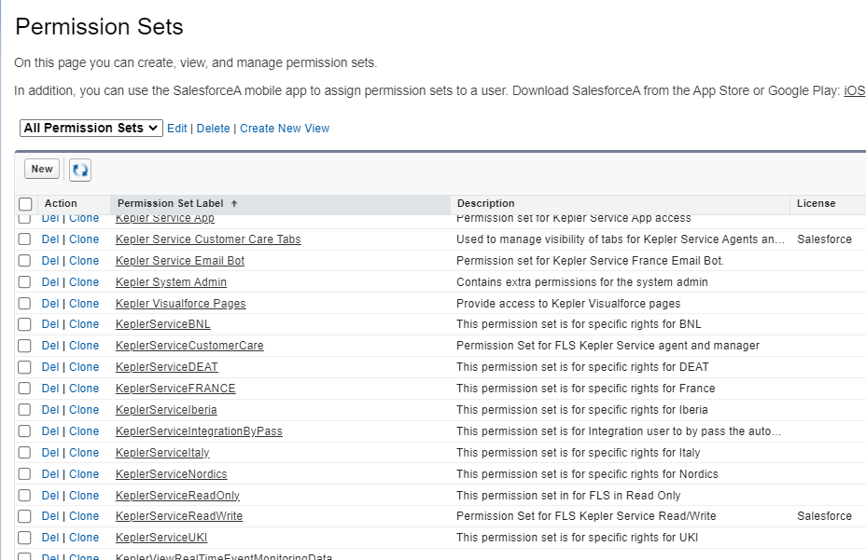
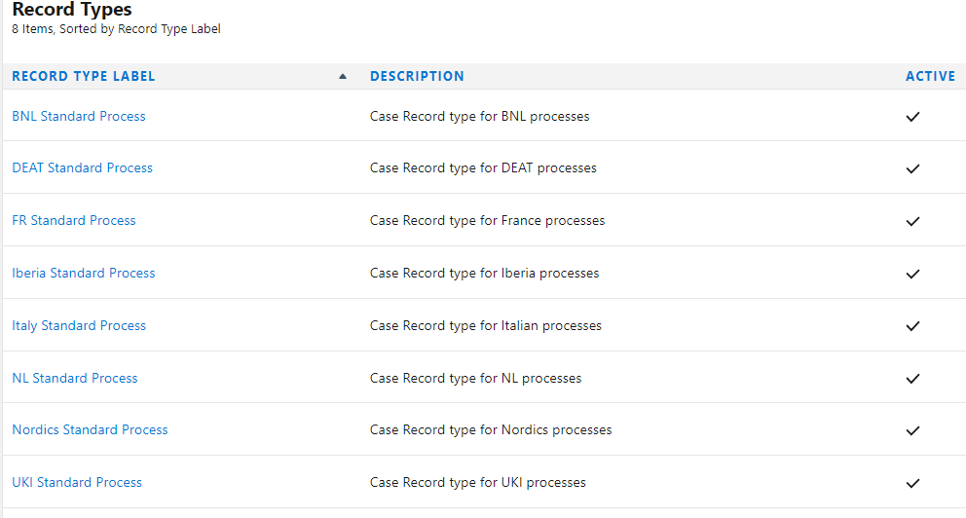
Product description
Service Permission sets :
2 pset groups (Manager & Agent)
1 pset specific per Hub
2 pset for integration purpose (Read/Write and Read Only)
Nothing on profiles !
Cases set up :
1 record type per Hub
1 Page layout per Hub
2 Lightning record page

Slide 13
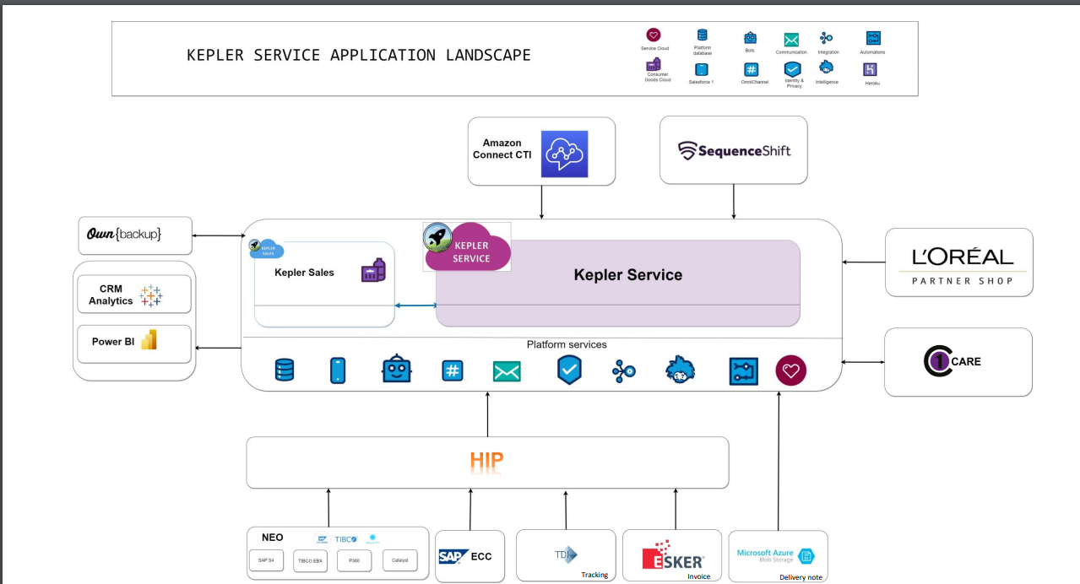
ARCHITECTURE

Slide 14
Roadmap 2024
3

Slide 15
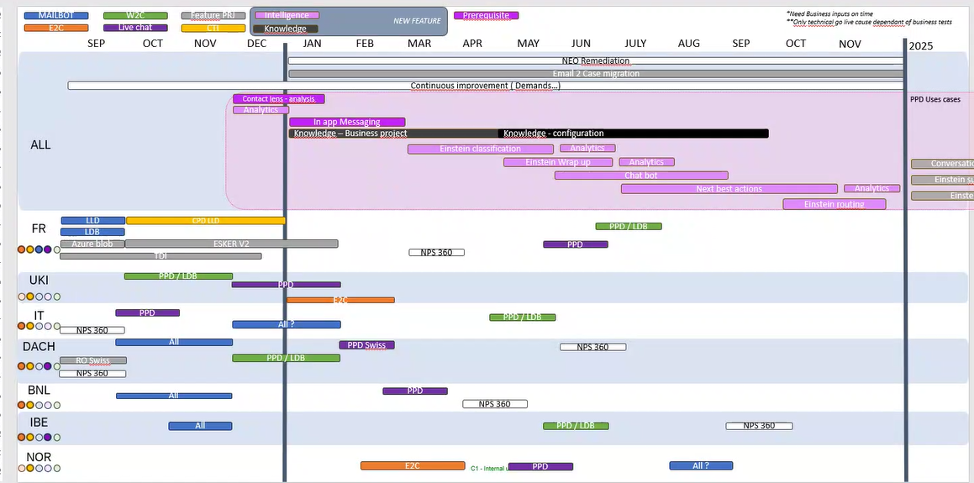

Slide 16
Processes
4

Slide 17
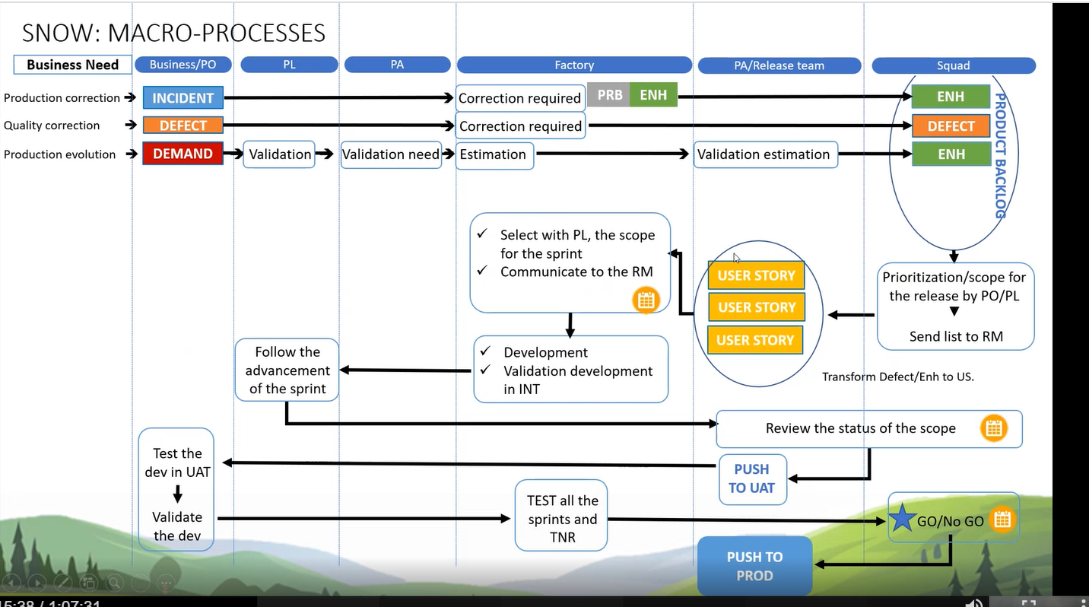
SNOW PROCESSES
VOCABULARY :
Demand = DMND
Enhancement = ENHC
User story = US
Defect = DFCT
Incident = INC
Problem = PRB
HIERARCHY :
DMND > ENHC > US
1 DMND can have n ENHC and n US
BUT 1 ENHC = 1US
And 1 US can be only linked to 1 DMND

Slide 18
BACKLOG
Present functionnal need to TL
Demand added in « Demand Backlog »
Business need checked by PL/PA
BA grooming/workshops
TL IT Solution
Demand Assess/Rejected
Back & Forth
PA Approval
If KO
BA to add it
US Created to add in backlog
Test QA
US sent to UAT
Dev US in devconfig
Estimation
If OK
If KO
Test business
Ready to Prod
If OK
https://loreal.sharepoint.com/:x:/r/sites/-FR-KEPLER-PROCESSKNOWLEDGEBASE/_layouts/15/doc2.aspx?sourcedoc=%7B414266c2-5df7-429e-ac55-50a724129662%7D&action=edit&activeCell=%27BACKLOG%20FOLLOW-UP%27!K10242&wdinitialsession=a0ebe60e-c279-4f17-a1c3-f27a402370d1&wdrldsc=137&wdrldc=1&wdrldr=AccessTokenExpiredWarning%2CRefreshingExpiredAccessT

Slide 19
Features
5

Slide 20
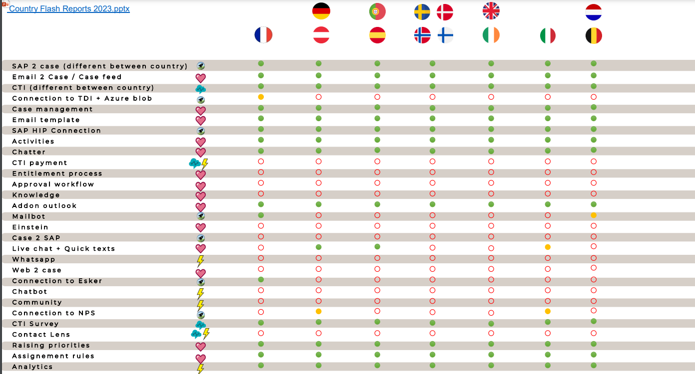
FEATURES BY HUB

Slide 21
Mailbot
Custom feature to enhance the standard email2case, base on « Email Services »
Kepler Service’s mailbot should help agents to deal with cases and :
Maximize filling of mandatory fields
Choose the right queue / the right agent as case owner
Qualify / typify case when it is created (type, case type, sub-type, priority, status, etc)
Thanks to 7 criterias found in the email subject
Keyword
Inbound email address (carrier, business teams, etc)
Delivery number
CTI phone number
Invoice number (SAP invoice number)
Order number (SAP ORDER number)
Email-to-case logic (customer email addresses)
Efficiency
Productivity
Processing speed
time dedicated to added value tasks

Slide 22



MAILBOT WORKING / logical sequence
Mandatory for Transportation Services
Usefull for voicemail CTI functionnality
Email
Keyword
No
Specific inbound email address
No
Delivery number
No
CTI phone number
No
SAP sales order number
No
SAP invoice number
No
Inbound customer emails address (contacts)
Yes
Yes
Yes
Yes
Yes
Yes
Yes
Case creation with a part or all of the mandatory fields filled, depends of which criteria matched
Email-to-case logic
Mailbot logic
Mailbot works by sequence
Maximize case filling
As soon as it finds a criteria, it stops and creates a case with a predefined filling of mandatory and additionnal fields (set in hard code or in « Email-to-case Routing managers » module)
Goals :
Keep mailbot performance
Avoid bugs. Depends of the different rules created, mailbot won’t know which one must be applied
If mailbot finds account code or SAP document number(s), account name and/or SAP document fields will be filled in
22

